Slide 1
PA Education education – research – employability - integration
8 February 2017 | Baltic Sea Science Day | St. Petersburg

Slide 2
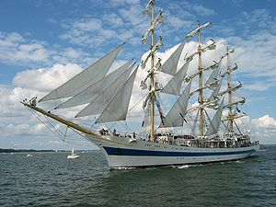

Flagships – development processes

Slide 3
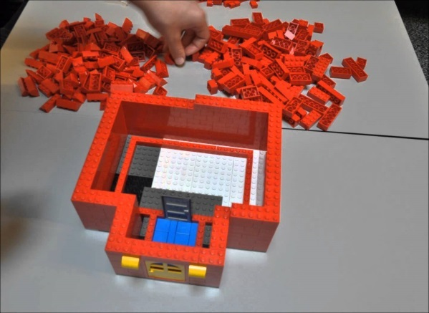
Flagships – development processes
Flagships – development processes
Gather stakeholders in a multilevel governance perspective – stakeholders with capacity for development, implementation and providing sustainable impact.
A mix of thematic platforms and projects.
Projects with different financing depending on the partnership and type of development.

Slide 4

4 policy areas
EUSBSR PA Education – in brief
Education
Research
Employability
Integration of refugees
2 policy area coordinators
Solveg Schmidt (Hamburg)
Anders Bergström (Norden Association in Sweden)
5 actions
Reducing the rates of early school leaving and smoothening transition from school to work
Improving the quality of VET and Higher Education through work based learning and fostering entrepreneurial mind sets
International excellence in higher education and research
A labour market for all and using resources of longer lives
Recognising potential – easing the way for migrants

Slide 5
More information
Solveg Schmidt solveg.schmidt@hibb.hamburg.de
Anders Bergström anders.bergstrom@norden.se
Anastasiia Klonova anastasiia.klonova@norden.se
Website http://groupspaces.com/eusbsr-education/
Twitter https://twitter.com/bsreducation

